Slide 1
Programming with C++ BCAN – E302A

Slide 2
Module – I Concepts of OOP

Slide 3
Introduction to C++ -
C++, as we all know is an extension to C language and was developed by Bjarne Stroustrup at bell labs.
C++ is an intermediate level language, as it comprises a confirmation of both high level and low level language features.
C++ is a statically typed, free form, multi-paradigm, compiled general-purpose language.
C++ is an Object Oriented Programming language but is not purely Object Oriented, due to its features like Friend and Virtual, violate some of the very important OOPS features, rendering this language unworthy of being called completely Object Oriented.

Slide 4
Benefits of C++ over C Language -
Following features of C++ makes it a stronger language than C –
There is Stronger Type Checking in C++.
All the OOPS features in C++ like Abstraction, Encapsulation, Inheritance etc makes it more worthy and useful for programmers.
C++ supports and allows user defined operators (i.e Operator Overloading) and function overloading is also supported in it.
Exception Handling is there in C++.
The Concept of Virtual functions and also Constructors and Destructors for Objects.
Inline Functions in C++ instead of Macros in C language. Inline functions make complete function body act like Macro, safely.
Variables can be declared anywhere in the program in C++, but must be declared before they are used.

Slide 5
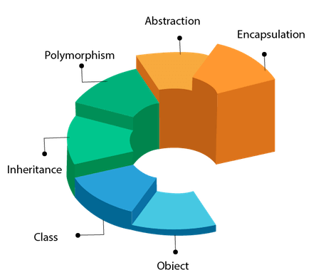
Object Oriented Programming -
Object Oriented programming is a programming style that is associated with the concept of Class, Objects and various other concepts revolving around these two, like Inheritance, Polymorphism, Abstraction, Encapsulation etc.

Slide 6
Object Oriented Programming -
Class - A class is a blueprint for any functional entity which defines its properties and its functions.
Objects - An Object is an instance of a Class. When a class is defined, no memory is allocated but when it is instantiated (i.e. an object is created) memory is allocated.
Polymorphism - When one task is performed by different ways i.e. known as polymorphism. In C++, Function overloading and Function overriding to achieve polymorphism.
Inheritance - When one object acquires all the properties and behaviors of parent object i.e. known as inheritance. It provides code reusability. It is used to achieve runtime polymorphism.
Abstraction - Hiding internal details and showing functionality is known as abstraction. In C++, we use abstract class and interface to achieve abstraction.
Encapsulation - Binding (or wrapping) code and data together into a single unit is known as encapsulation.

Slide 7
Advantages of OOP over POP language -
OOPs makes development and maintenance easier where as in Procedure-oriented programming language it is not easy to manage if code grows as project size grows.
OOPs provide data hiding whereas in Procedure-oriented programming language a global data can be accessed from anywhere.
OOPs provide ability to simulate real-world event much more effectively. We can provide the solution of real word problem if we are using the Object-Oriented Programming language.

Slide 8
Module – II Basics of C++

Slide 9
First C++ Program -
#include <iostream.h>
using namespace std;
void main()
{
cout << "Hello this is C++";
}
Header files - Header files are included at the beginning just like in C program. Here iostream is a header file which provides us with input & output streams. Header files contained predeclared function libraries, which can be used by users for their ease.
Namespace std - Using namespace std, tells the compiler to use standard namespace. Namespace collects identifiers used for class, object and variables. Namespace can be used by two ways in a program, either by the use of using statement at the beginning, like we did in above mentioned program or by using name of namespace as prefix before the identifier with scope resolution (::) operator.

Slide 10
C++ Basic Input / Output -
C++ I/O operation is using the stream concept. Stream is the sequence of bytes or flow of data. It makes the performance fast.
If bytes flow from main memory to device like printer, display screen, or a network connection etc, this is called as output operation.
If bytes flow from device like printer, display screen, or a network connection etc to main memory, this is called as input operation.
- I/O Library Header Files –
Header File | Function and Description
<iostream> | It is used to define the cout, cin and cerr objects, which correspond to standard output stream, standard input stream and standard error stream, respectively.
<iomanip> | It is used to declare services useful for performing formatted I/O, such as setprecision and setw.
<fstream> | It is used to declare services for user-controlled file processing.

Slide 11
Standard output stream (cout) -
The cout is a predefined object of ostream class. It is connected with the standard output device, which is usually a display screen. The cout is used in conjunction with stream insertion operator (<<) to display the output on a console.
#include <iostream.h>
void main()
{
cout << "Hello this is C++";
}

Slide 12
Standard input stream (cin) -
The cin is a predefined object of istream class. It is connected with the standard input device, which is usually a keyboard. The cin is used in conjunction with stream extraction operator (>>) to read the input from a console.
#include <iostream.h>
using namespace std;
void main( )
{
int age;
cout << "Enter your age: ";
cin >> age;
cout << "Your age is: " << age << endl;
}

Slide 13
Standard end line (endl) -
The cin is a predefined object of istream class. It is connected with the standard input device, which is usually a keyboard. The cin is used in conjunction with stream extraction operator (>>) to read the input from a console.
#include <iostream.h>
using namespace std;
void main( )
{
int age;
cout << "Enter your age: ";
cin >> age;
cout << "Your age is: " << age << endl;
}

Slide 14
Escape Sequence -
Certain sequences of symbols make special meaning to the computer. They are called escape sequences
Escape Sequence starts with a backslash (\). It is actually just one special character.
Useful escape sequences –
Example –
cout<<“Hello\nWorld”
Topics | Symbols
New – Line | \n
Horizontal Tab | \t
Alert | \a
Vertical Tab | \v
Backslash | \\
Double Quote | \”

Slide 15
C++ Variable -
A variable is a name of memory location. It is used to store data. Its value can be changed and it can be reused many times. It is a way to represent memory location through symbol so that it can be easily identified.
Syntax - type variable_list;
Rules for defining variables -
A variable can have alphabets, digits and underscore.
A variable name can start with alphabet and underscore only. It can't start with digit.
No white space is allowed within variable name.
A variable name must not be any reserved word or keyword e.g. char, float etc.

Slide 16
Scope of Variables -
All the variables have their area of functioning, and out of that boundary they don't hold their value, this boundary is called scope of the variable.
We can broadly divide variables into two main types –
Global Variables
Local Variables
Global variables -
Global variables are those, which are once declared and can be used throughout the lifetime of the program by any class or any function.
They must be declared outside the main() function. If only declared, they can be assigned different values at different time in program lifetime.
But even if they are declared and initialized at the same time outside the main() function, then also they can be assigned any value at any point in the program.

Slide 17
Global Variables -
Example –
#include<iostream.h>
int x; // Global variable declared
void main()
{
x=10;
cout <<"first value of x = "<< x;
x=20;
cout <<"Initialized again with value = "<< x;
}

Slide 18
Local Variables -
Local variables are the variables which exist only between the curly braces, in which its declared. Outside that they are unavailable and leads to compile time error.
Example -
#include<iostream.h>
void main()
{
int a = 10;
if( a < 20)
{
int n=100; // Local variable declared and initialized
}
cout << n; // Compile time error, n not available here
}

Slide 19
Some special types of variable -
There are also some special keywords, to impart unique characteristics to the variables in the program.
Final - Once initialized, its value cant be changed.
Static - These variables holds their value between function calls.
Example -
#include <iostream.h>
void main()
{
final int i=10;
static int y=20;
}

Slide 20

C++ datatypes -
A data type specifies the type of data that a variable can store such as integer, floating, character etc.

Slide 21
C++ datatypes -
There are 4 types of data types in C++ language –
Types | Data Types
Basic Data Type | int, char, float, double etc.
Derived Data Type | array, pointer etc.
Enumeration Data Type | enum
User Defined Data Type | Structure, union etc.

Slide 22
Basic Data Types -
The basic data types are integer-based and floating-point based. C++ language supports both signed and unsigned literals. The memory size of basic data types may change according to 32 or 64 bit operating system.
Data Types | Memory Size | Range
char | 1 byte | -128 to 127
signed char | 1 byte | -128 to 127
unsigned char | 1 byte | 0 to 127
short | 2 byte | -32,768 to 32,767
signed short | 2 byte | -32,768 to 32,767
unsigned short | 2 byte | 0 to 32,767
int | 2 byte | -32,768 to 32,767
signed int | 2 byte | -32,768 to 32,767

Slide 23
Basic Data Types -
The basic data types are integer-based and floating-point based. C++ language supports both signed and unsigned literals. The memory size of basic data types may change according to 32 or 64 bit operating system.
Data Types | Memory Size | Range
unsigned int | 2 byte | 0 to 32,767
short int | 2 byte | -32,768 to 32,767
signed short int | 2 byte | -32,768 to 32,767
unsigned short int | 2 byte | 0 to 32,767
long int | 4 byte
signed long int | 4 byte
unsigned long int | 4 byte
float | 4 byte
double | 8 byte
long double | 10 byte

Slide 24
Modifiers in C++ program -
In C++, special words(called modifiers) can be used to modify the meaning of the predefined built-in data types and expand them to a much larger set.
There are four datatypes modifiers in C++, they are -
long 3. short
signed 4. unsigned
Important points -
long and short modify the maximum and minimum values that a data type will hold.
A plain int must have a minimum size of short.
Size hierarchy : short int < int < long int
Size hierarchy for floating point numbers is : float < double < long double
long float is not a legal type and there are no short floating point numbers.
Signed types includes both positive and negative numbers and is the default type.
Unsigned, numbers are always without any sign, that is always positive.

Slide 25
C++ Keywords -
A keyword is a reserved word. A list of 32 Keywords in C++ Language which are also available in C language are given below.
auto | break | case | char | const | continue | default | do
double | else | enum | extern | float | for | goto | if
int | long | register | return | short | signed | sizeof | static
struct | switch | typedef | union | unsigned | void | volatile | while

Slide 26
C++ Keywords -
A list of 30 Keywords in C++ Language which are not available in C language are given below.
asm | dynamic_cast | namespace | reinterpret_cast | bool
explicit | new | static_cast | false | catch
operator | template | friend | private | class
this | inline | public | throw | const_cast
delete | mutable | protected | true | try
typeid | typename | using | virtual | wchar_t

Slide 27
Comments in C++ Program -
For single line comments, use // before mentioning comment, like –
cout<<"single line"; // This is single line comment
For multiple line comment, enclose the comment between /* and */ -
/*this is a multiple line comment */

Slide 28
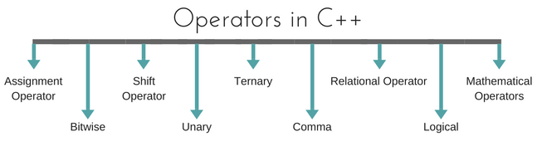
Operators -
An operator is simply a symbol that is used to perform operations. There can be many types of operations like arithmetic, logical, bitwise etc.
Types of Operators -

Slide 29
Assignment Operator (=) -
Operates '=' is used for assignment, it takes the right-hand side (called rvalue) and copy it into the left-hand side (called lvalue).
Assignment operator is the only operator which can be overloaded but cannot be inherited.
#include<iostream.h>
#include<conio.h>
int main()
{
int a = 10;
cout<<"Value of a: "<<a;
return 0;
}

Slide 30
Mathematical Operators -
There are operators used to perform basic mathematical operations. Addition (+) , subtraction (-) , division (/) multiplication (*) and modulus (%) are the basic mathematical operators. Modulus operator cannot be used with floating-point numbers.
C++ and C also use a shorthand notation to perform an operation and assignment at same type.
Example –
int x = 10;
x = x + 4 equivalent to x += 4
x = x – 5 equivalent to x -= 5

Slide 31
Relational Operators -
These operators establish a relationship between operands.
The relational operators are: less than (<), grater than (>), less than or equal to (<=), greater than equal to (>=), equivalent (==) and not equivalent (!=).
Difference between equal and equivalent - We must notice that assignment operator is (=) and there is a relational operator, for equivalent (==).
These two are different from each other, the assignment operator assigns the value to any variable, whereas equivalent operator is used to compare values, like in if-else conditions
Example –
int x = 10; // assignment operator
x=5; // assignment operator
if(x == 5) // relational operator
{
cout <<"Successfully compared";
}

Slide 32
Logical Operators -
The logical operators are AND (&&) and OR (||).
They are used to combine two different expressions together.
If two statement are connected using AND operator, the validity of both statements will be considered, but if they are connected using OR operator, then either one of them must be valid. These operators are mostly used in loops (especially while loop) and in Decision making.
There are basically 3 types of logical operators such as –
Logical AND (&&)
Logical OR (||)
Logical NOT (!)

Slide 33
Bitwise Operators -
There are used to change individual bits into a number.
They work with only integral data types like char, int and long and not with floating point values.
Bitwise AND operators (&)
Bitwise OR operator (|)
Bitwise XOR operator (^)
Bitwise NOT operator (~)
Example

Slide 34
Shift Operators -
Shift Operators are used to shift Bits of any variable. It is of three types,
Left Shift Operator (<<)
Right Shift Operator (>>)
Example

Slide 35
Unary Operators -
These are the operators which work on only one operand.
There are many unary operators, but increment ++ and decrement -- operators are most used.

Slide 36
Ternary Operators -
The ternary if-else ? : is an operator which has three operands.
Example –
int a = 10;
a > 5 ? cout << "true" : cout << "false"

Slide 37
Comma Operators -
This is used to separate variable names and to separate expressions. In case of expressions, the value of last expression is produced and used.
Example –
int a,b,c; // variables declaration using comma operator
a=b++, c++; // a = c++ will be done.

Slide 38
sizeOf Operators in C++ -
sizeOf() is also an operator not a function, it is used to get information about the amount of memory allocated for data types & Objects.
It can be used to get size of user defined data types too.
sizeOf() operator can be used with and without parentheses. If you apply it to a variable you can use it without parentheses.
Example –
cout << sizeOf(double); //Will print size of double
int x = 2;
int a = sizeOf x;

Slide 39
typedef Operators in C++ -
typedef is a keyword used in C language to assign alternative names to existing types.
Its mostly used with user defined data types, when names of data types get slightly complicated.
Following is the general syntax for using typedef, it can be used to get size of user defined data types too.
Syntax - typedef existing_name alias_name;
Example - typedef unsigned long ulong;
ulong i, j;

Slide 40
Conditional Statement in C++ -
In C++ programming, if statement is used to test the condition. There are various types of if statements in C++.
Simple If Statement - The C++ if statement tests the condition. It is executed if condition is true.
Syntax -
if(condition)
{
//code to be executed
}
Simple if statement | Nested if-else statement
if-else statement | if-else-if ladder

Slide 41
Source Code of Simple - if statement -
#include<iostream.h>
#include<conio.h>
void main ()
{
int num = 10;
if (num % 2 == 0)
{
cout<<"It is even number";
}
}

Slide 42
If-else Statement -
The C++ if-else statement also tests the condition. It executes if block if condition is true otherwise else block is executed.
Syntax –
if(condition)
{
//code if condition is true
}
else
{
//code if condition is false
}

Slide 43
Source Code of if-else statement -
#include<iostream.h>
#include<conio.h>
void main ()
{
int num = 10;
if (num % 2 == 0) {
cout<<"It is even number";
}
else {
cout<<"It is odd number";
}
}

Slide 44
Nested if-else Statement -
A nested if is an if statement that is the target of another if statement. Nested if statements means an if statement inside another if statement.
Syntax –
if (condition1)
{
// Executes when condition1 is true
if (condition2) {
// Executes when condition2 is true
}
else {
// Executes when condition2 is false
}
}

Slide 45
Source Code of if-else statement -
#include<iostream.h>
#include<conio.h>
void main()
{
int i = 10;
if (i == 10) {
if (i < 15) {
cout<<"i is smaller than 15";
}
if (i < 12) {
cout<<"i is smaller than 12 too";
}
else {
cout<<"i is greater than 15";
}
}
}

Slide 46
if-else-if ladder Statement -
Syntax –
if (condition) {
//statement;
}
else if (condition) {
//statement;
}
.
.
.
else {
//statement;
}

Slide 47
Source Code of if-else-if ladder statement -
#include<iostream.h>
#include<conio.h>
void main()
{
int i = 20;
if (i == 10)
cout<<"i is 10";
else if (i == 15)
cout<<"i is 15";
else if (i == 20)
cout<<"i is 20";
else
cout<<"i is not present";
}

Slide 48
Switch Case Statement -
The C++ switch statement executes one statement from multiple conditions. It is like if-else-if ladder statement in C++.
Syntax –
switch(expression)
{
case value1: //code to be executed; break;
case value2: //code to be executed; break;
......
default: //if all cases are not matched; break;
}

Slide 49
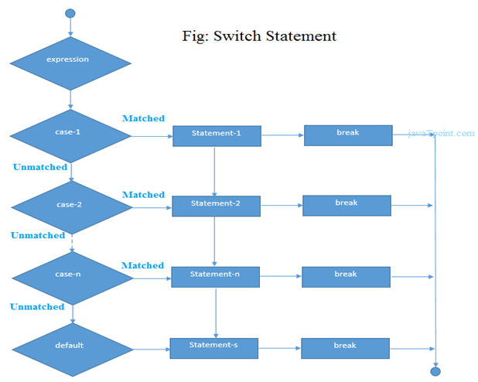

Slide 50
Example –
#include<iostream.h>
#include<conio.h>
void main ()
{
int num;
cout<<"Enter a number to check grade:";
cin>>num;
switch (num)
{
case 10: cout<<"It is 10"; break;
case 20: cout<<"It is 20"; break;
case 30: cout<<"It is 30"; break;
default: cout<<"Not 10, 20 or 30"; break;
}
}

Slide 51
For Loop -
The C++ for loop is used to iterate a part of the program several times. If the number of iteration is fixed, it is recommended to use for loop than while or do-while loops.
The C++ for loop is same as C. We can initialize variable, check condition and increment/decrement value.
Syntax –
for(initialization; condition; incr/decr)
{
//code to be executed
}

Slide 52
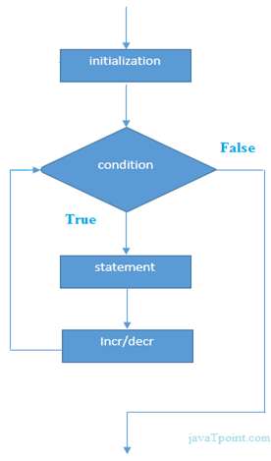
Example –
#include<iostream.h>
#include<conio.h>
void main()
{
int i;
for(i=1;i<=10;i++)
{
cout<<i <<"\n";
}
}

Slide 53
While Loop -
C++ while loops statement allows to repeatedly run the same block of code until a condition is met.
while loop is a most basic loop in C++. while loop has one control condition, and executes as long the condition is true.
The condition of the loop is tested before the body of the loop is executed, hence it is called an entry-controlled loop.
Syntax –
while (condition)
{
statement(s);
Incrementation;
}

Slide 54
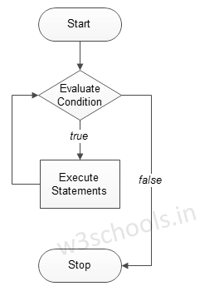
Example –
#include<iostream.h>
#include<conio.h>
void main()
{
int i=1;
while(i<=10)
{
cout << “\t”<<i;
i++;
}
}

Slide 55
Do-while Loop -
C++ do while loops are very similar to the while loops, but it always executes the code block at least once and furthermore as long as the condition remains true.
This is an exit-controlled loop.
Syntax –
do
{
statement(s);
increamentation;
}while( condition );

Slide 56
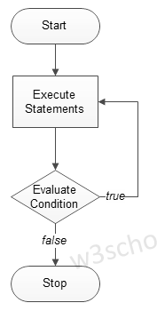
Example –
#include<iostream.h>
#include<conio.h>
void main()
{
int i=1;
do{
cout << “\t” <<i;
i++;
} while(i<=10);
}

Slide 57
User defined functions -
In programming, function refers to a segment that groups code to perform a specific task. Depending on whether a function is predefined or created by programmer; there are two types of function:
Library Function
User-defined Function
Library Function – Library functions are the built-in function in C++ programming. Programmer can use library function by invoking function directly; they don't need to write it themselves.
User defined Function - C++ allows programmer to define their own function. A user-defined function groups code to perform a specific task and that group of code is given a name(identifier). When the function is invoked from any part of program, it all executes the codes defined in the body of function.

Slide 58
Example 1: Library Function -
#include<iostream.h>
#include<cmath.h>
void main()
{
double number, squareRoot;
cout << "Enter a number: ";
cin >> number;
squareRoot = sqrt(number);
cout << "Square root of " << number << " = " << squareRoot;
}

Slide 59
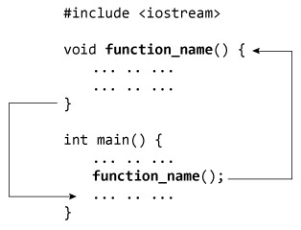
How user-defined function works in C Programming?

Slide 60
Example 2: User Defined Function -
#include<iostream.h>
// Function prototype (declaration)
int add(int, int);
void main()
{
int num1, num2, sum;
cout<<"Enters two numbers to add: ";
cin >> num1 >> num2;
// Function call
sum = add(num1, num2);
cout << "Sum = " << sum;
}
// Function definition
int add(int a, int b)
{
int add;
add = a + b;
// Return statement
return add;
}

Slide 61
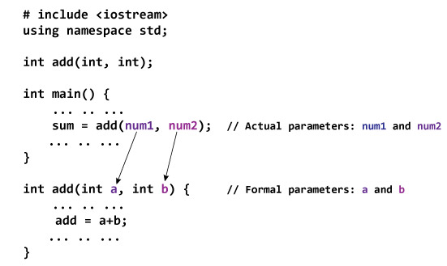
Passing Arguments to Function -

Slide 62
Different types of user defined functions -
With out return type, with out parameters
With out return type, with parameters
With return type, with out parameters
With return type, with parameters

Slide 63
With out return type, with out parameters -
#include<iostream.h>
#include<conio.h>
void add();
void main()
{
clrscr();
add();
getch();
}
void add()
{
int a,b,c=0;
cout<<“Enter the numbers: ”;
cin>>a>>b;
c = (a + b);
cout<<“Sum is: ”<<c;
}

Slide 64
With out return type, with parameters -
#include<iostream.h>
#include<conio.h>
void add(int a, int b);
void main()
{
int p,q;
cout<<“Enter numbers: ”;
cin>>p>>q;
add(p,q);
}
void add(int a, int b)
{
c = (a + b);
cout<<“Sum is: ”<<c;
}

Slide 65
With return type, with out parameters -
#include<iostream.h>
#include<conio.h>
int add();
void main()
{
int p;
cout<<“Enter numbers: ”;
cin>>p;
p = add();
cout<<“Sum is: ”<<c;
}
int add()
{
int a,b,c;
cout<<“Enter numbers: ”;
cin>>a>>b;
c = (a + b);
return c;
}

Slide 66
With return type, with parameters -
#include<iostream.h>
#include<conio.h>
int add(int a, int b);
void main()
{
int p, q, sum = 0;
cout<<“Enter numbers: ”;
cin>>p>>q;
sum = add(p,q);
cout<<“Sum is: ”<<c;
}
int add(int a, int b)
{
c = (a + b);
return c;
}

Slide 67
Default Arguments -
One of the most useful facilities in C++, to define default arguments for function.
In the function prototype declaration, default arguments are given.
#include<iostream> #include<conio.h> void sum(int a, int b=10); void main() { int p; cout<<"Enter the number: "; cin>>p; sum(p); } | void sum(int x, int y) { int z = (x + y); cout<<"Sum is: "<<z; }

Slide 68
Class -
The building block of C++ that leads to Object Oriented programming is a Class. It is a user defined data type, which holds its own data members and member functions, which can be accessed and used by creating an instance of that class.
A class is like a blueprint for an object.
Each and every class has two specific properties –
Member Variables
Member Functions
There are 2 ways to define a member function:
Type – I: Inside class definition
Type – II: Outside class definition

Slide 69
Object -
An Object is an instance of a Class. When a class is defined, no memory is allocated but when it is instantiated (i.e. an object is created) memory is allocated.
Declaring Objects - When a class is defined, only the specification for the object is defined; no memory or storage is allocated. To use the data and access functions defined in the class, you need to create objects.
Syntax: ClassName ObjectName;

Slide 70
How to define Class & Object – (Type – I)
#include<iostream.h>
#include<conio.h>
class Sample {
private:
int a,b,c;
public:
void calc()
{
cout << “Enter numbers: ”;
cin>>a>>b;
c = (a + b);
cout << “Sum is: ”<<c;
}
};
void main()
{
Sample obj;
clrscr();
obj.calc() ;
getch();
}

Slide 71
How to define Class & Object – (Type – II)
#include<iostream.h>
#include<conio.h>
class Sample {
private:
int a,b,c;
public:
void calc();
};
void Sample :: calc() {
cout << “Enter numbers: ”;
cin>>a>>b;
c = (a + b);
cout << “Sum is: ”<<c;
}
void main()
{
Sample obj;
clrscr();
obj.calc() ;
getch();
}
Note: :: is known as Scope Resolution Operator.

Slide 72
Constructor -
In C++, constructor is a special method which is invoked automatically at the time of object creation. It is used to initialize the data members of new object generally.
The constructor in C++ has the same name as class or structure.
There can be two types of constructors in C++.
Default constructor
Parameterized constructor
Default Constructor - A constructor which has no argument is known as default constructor. It is invoked at the time of creating object.
Parameterized Constructor - A constructor which has parameters is called parameterized constructor. It is used to provide different values to distinct objects.

Slide 73
Example of Default Constructor -
#include<iostream.h>
#include<conio.h>
class Defal
{
public:
int x;
int y;
Defal()
{
x=0;
y=0;
}
};
void main()
{
Defal obj;
cout << “Default constructor”;
cout << obj.x ;
cout << obj.y ;
}

Slide 74
Example of Parameterized Constructor -
#include<iostream.h>
#include<conio.h>
class PrCons
{
public:
int x,y,z;
PrCons(int a, int b)
{
x = a;
y = b;
}
};
void main()
{
PrCons obj(10,20);
cout<<"\nValue of a: "<<obj.x;
cout<<"\nValue of b: "<<obj.y;
}

Slide 75
Example of Parameterized Constructor – (Type – II)
#include<iostream.h>
#include<conio.h>
class Rectangle
{
int width, height;
public:
Rectangle (int,int);
int area () {
return (width*height);
}
};
Rectangle::Rectangle (int a, int b) {
width = a;
height = b;
}
void main()
{
Rectangle rect (3,4);
Rectangle rectb (5,6);
cout<<“rect area: “<<rect.area();
cout<<“rectb area: “<<rectb.area() ;
}

Slide 76
Destructor -
A destructor is used to destroy the objects that have been created by a constructor.
Like constructor, the destructor is a member function whose name is the same as the class name but is preceded by a tilde.
A destructor never takes any argument nor does it return any value.
It will be invoked implicitly by the compiler upon exit from the program – or block or function as the case may be – to clean up storage that is no longer accessible.
It is a good practice to declare destructors in a program since it releases memory space for further use.
Note - C++ destructor cannot have parameters. Moreover, modifiers can't be applied on destructors.

Slide 77
Example of Destructor -
#include<iostream.h>
#include<conio.h>
class Destruct
{
public:
Destruct()
{
cout<<"Constructor Invoked"<<endl;
}
~Destruct()
{
cout<<"Destructor Invoked"<<endl;
}
};
void main()
{
Destruct e1;
}

Slide 78
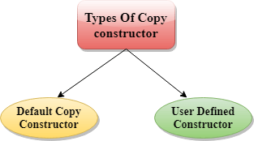
C++ Copy Constructor –
A Copy constructor is an overloaded constructor used to declare and initialize an object from another object.
Copy Constructor is of two types -
Default Copy constructor - The compiler defines the default copy constructor. If the user defines no copy constructor, compiler supplies its constructor.
User Defined constructor - The programmer defines the user-defined constructor.

Slide 79
Explanation of Copy Constructor -
A copy constructor is used to declare and initialize an object from another object.
The process of initializing through a copy constructor is known as copy initialization.
A reference variable has been used as an argument to the copy constructor.
We cannot pass the argument by value to a copy constructor.
The copy constructors are used in the following situations –
>> The initialization of an object by another object of the same class.
>> Return of objects as a function value.
>> Starting the object as by value parameters of a function.

Slide 80
Example of Copy Constructor -
#include<iostream.h>
#include<conio.h>
class Example{
int a, b;
public:
Example(int x, int y){
a = x;b = y;
}
Example(const Example& obj){
a = obj.a;b = obj.b;
}
void Display(){
cout << "\nValues :" << a << "\t" << b;
}
};
void main()
{
//Normal Constructor Invoked
Example Object(10, 20);
//Copy Constructor Invoked - Method 1
Example Object2(Object);
//Copy Constructor Invoked - Method 2
Example Object3 = Object;
Object.Display();
Object2.Display();
Object3.Display();
}

Slide 81
Multiple Constructors in a class -
C++ permits to use more than one constructors in a single class -
MultConstructors(); //No arguments
MultConstructors(int x, int y); // Two arguments

Slide 82
#include<iostream>
#include<conio.h>
class MultConstructors
{
public:
int a,b,c;
MultConstructors()
{
c = 0;
}
MultConstructors(int x, int y)
{
a = x;
b = y;
}
};
void main()
{
MultConstructors mDObj;
cout<<"Value is: "<<mDObj.a<<"\t"<<mDObj.b;
MultConstructors mPObj(1,2);
cout<<"\nValue is: "<<mPObj.a<<"\t"<<mPObj.b;
c = (a + b);
cout<<“Sum is: ”<<c;
}

Slide 83
Constructor with Default Arguments -
It is possible to define constructors with default arguments.
#include<iostream.h>
#include<conio.h>
class Sample
{
private:
int a, b, c;
public:
Sample(int x = 10, int y = 20){
a = x;
b = y;
}
void show(){
cout<<“value is: ”<<a;
cout<<“value is: ”<<b;
}
};

Slide 84
C++ static –
In C++, static is a keyword or modifier that belongs to the type not instance. So instance is not required to access the static members.
In C++, static can be field, method, constructor, class, properties, operator and event.
Advantages –
Memory efficient - Now we don't need to create instance for accessing the static members, so it saves memory. Moreover, it belongs to the type, so it will not get memory each time when instance is created.
Static Variables - Variables in a function, Variables in a class.
Static Field – A field which is declared as static is called static field. Unlike instance field which gets memory each time whenever you create object, there is only one copy of static field created in the memory. It is shared to all the objects.

Slide 85
Static variables in a function –
When a variable is declared as static, space for it gets allocated for the lifetime of the program. Even if the function is called multiple times, space for the static variable is allocated only once and the value of variable in the previous call gets carried through the next function call.
#include<iostream.h>
#include<string>
void demo()
{
static int count = 0;
cout << count << " ";
count++;
}
void main()
{
for (int i=0; i<5; i++)
{
demo();
}
}

Slide 86
Static variables in a class –
As the variables declared as static are initialized only once as they are allocated space in separate static storage so, the static variables in a class are shared by the objects. There can not be multiple copies of same static variables for different objects. Also because of this reason static variables can not be initialized using constructors.
#include<iostream.h>
#include<conio.h>
class GfG
{
public:
static int i;
GfG()
{
//i = 0;
}
};
int GfG :: i = 999;
int main()
{
GfG obj1;
cout<<obj1.i<<endl;
GfG obj2;
obj1.i =2;
obj2.i = 3;
cout << obj1.i<<" "<<obj2.i;
return 0;
}

Slide 87
Static Members of Class –
Class objects as static - Just like variables, objects also when declared as static have a scope till the lifetime of program.
#include<iostream.h>
#include<conio.h>
class GfG
{
int i = 0;
public:
GfG()
{
i = 0;
cout << "Inside Constructor\n";
}
~GfG()
{
cout << "Inside Destructor\n";
}
};
void main()
{
int x = 0;
if (x==0)
{
static GfG obj;
}
cout << "End of main\n";
}

Slide 88
Static functions in a class -
Just like the static data members or static variables inside the class, static member functions also does not depend on object of class. We are allowed to invoke a static member function using the object and the ‘.’ operator but it is recommended to invoke the static members using the class name and the scope resolution operator. Static member functions are allowed to access only the static data members or other static member functions, they can not access the non-static data members or member functions of the class.
#include<iostream.h>
#include<conio.h>
class GGI
{
public:
static void printMsg()
{
cout<<"Welcome to GGI…";
}
};
void main()
{
GfG::printMsg();
}

Slide 89
Structure in C++ -
C++ Structure is a collection of different data types. It is similar to the class that holds different types of data.
Syntax - struct structure_name
{
// member declarations.
}
Example - struct Student
{
char name[20];
int id;
int age;
}
How to create the instance of Structure? - Structure variable can be defined as - Student s;
How to access the variable of Structure? - The variable of the structure can be accessed by simply using the instance of the structure followed by the dot (.) operator and then the field of the structure. For example - s.id = 4;

Slide 90
#include<iostream.h>
#include<conio.h>
struct Rectangle
{
int width, height;
};
void main()
{
struct Rectangle rec;
rec.width=8;
rec.height=5;
cout<<"Area of Rectangle is: "<<(rec.width * rec.height);
}

Slide 91
#include<iostream.h>
#include<conio.h>
struct Rectangle
{
int width, height;
Rectangle(int w, int h)
{
width = w;
height = h;
}
void areaOfRectangle()
{
cout<<"Area of Rectangle is: "<<(width*height);
}
};
void main()
{
struct Rectangle rec=Rectangle(4,6);
rec.areaOfRectangle();
}

Slide 92
Instance Variables –
Instance variables are non-static variables and are declared in a class outside any method, constructor or block. As instance variables are declared in a class, these variables are created when an object of the class is created and destroyed when the object is destroyed.
Unlike local variables, we may use access specifiers for instance variables. If we do not specify any access specifier then the default access specifier will be used.
Initialization of Instance Variable is not Mandatory.
Instance Variable can be accessed only by creating objects.

Slide 93
#include<iostream.h>
#include<conio.h>
class Marks
{
public:
static int studentNumber;
int engMarks;
int mathsMarks;
int phyMarks;
public:
Marks()
{
++studentNumber;
};
};
int Marks::studentNumber = 0;
void main()
{
Marks obj1;
obj1.engMarks = 50;
obj1.mathsMarks = 80;
obj1.phyMarks = 90;
cout << Marks::studentNumber << endl;
cout << obj1.engMarks << endl;
cout << obj1.mathsMarks << endl;
cout << obj1.phyMarks << endl;
}

Slide 94
this pointer –
In C++ programming, this is a keyword that refers to the current instance of the class. There can be 3 main usage of this keyword in C++.
It can be used to pass current object as a parameter to another method.
It can be used to refer current class instance variable.
It can be used to declare indexers.
#include<iostream.h>
#include<conio.h>
class Employee
{
public:
int id;
string name;
float salary;
Employee(int id, string name, float salary)
{
this->id = id;
this->name = name;
this->salary = salary;
}
void display()
{
cout<<id<<" "<<name<<" "<<salary<<endl;
}
};

Slide 95
void main()
{
Employee e1 =Employee(101, "Sonoo", 890000);
Employee e2=Employee(102, "Nakul", 59000);
e1.display();
e2.display();
}

Slide 96
Errors -
Errors can be broadly categorized into two types. We will discuss them one by one.
Compile Time Errors
Run Time Errors
Latent Errors
Compile Time Errors – Errors caught during compiled time is called Compile time errors. Compile time errors include library reference; syntax error or incorrect class import.
Syntax Error
Logical Error
Run Time Errors - They are also known as exceptions. An exception caught during run time creates serious issues.

Slide 97
Exception Handling –
Exception Handling in C++ is a process to handle runtime errors. We perform exception handling so the normal flow of the application can be maintained even after runtime errors.
In C++, exception is an event or object which is thrown at runtime.
All exceptions are derived from std::exception class. It is a runtime error which can be handled. If we don't handle the exception, it prints exception message and terminates the program.
Advantage - It maintains the normal flow of the application. In such case, rest of the code is executed even after exception.

Slide 98
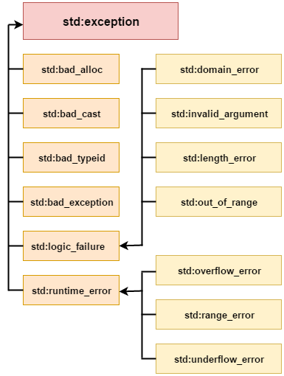
Exception Classes -
In C++ standard exceptions are defined in <exception> class that we can use inside our programs. The arrangement of parent-child class hierarchy is shown below –

Slide 99
Exception | Description
std::exception | It is an exception and parent class of all standard C++ exceptions.
std::logic_failure | It is an exception that can be detected by reading a code.
std::runtime_error | It is an exception that cannot be detected by reading a code.
std::bad_exception | It is used to handle the unexpected exceptions in a c++ program.
std::bad_cast | This exception is generally be thrown by dynamic_cast.
std::bad_typeid | This exception is generally be thrown by typeid.
std::bad_alloc | This exception is generally be thrown by new.
NOTE: In C++, we use 3 keywords to perform exception handling -
try
catch
throw

Slide 100
Try/catch Example -
#include<iostream.h>
#include<conio.h>
float division(int x, int y)
{
if( y == 0 )
{
throw "Attempted to divide by zero!";
}
return (x/y);
}
void main ()
{
int i = 25;
int j = 0;
float k = 0;
try
{
k = division(i, j);
cout << k << endl;
}
catch (const char* e)
{
cerr << e << endl;
}
}

Slide 101
Friend Function -
If a function is defined as a friend function in C++, then the protected and private data of a class can be accessed using the function.
By using the keyword friend, compiler knows the given function is a friend function.
For accessing the data, the declaration of a friend function should be done inside the body of a class starting with the keyword friend.
Declaration of friend function in C++ -
class class_name
{
friend data_type function_name(argument/s);
};
NOTE - In the above declaration, the friend function is preceded by the keyword friend. The function can be defined anywhere in the program like a normal C++ function. The function definition does not use either the keyword friend or scope resolution operator.

Slide 102

Characteristics of a Friend Function -
The function is not in the scope of the class to which it has been declared as a friend.
It cannot be called using the object as it is not in the scope of that class.
It can be invoked like a normal function without using the object.
It cannot access the member names directly and has to use an object name and dot membership operator with the member name.
It can be declared either in the private or the public part.

Slide 103
#include<iostream.h>
#include<conio.h>
class Box
{
private:
int length;
public:
Box()
{
length = 0;
}
friend int printLength(Box);
};
int printLength(Box b1)
{
b1.length += 10;
return b1.length;
}
void main()
{
Box b;
cout<<"Length of box: "<< printLength(b)<<endl;
}
Example of Friend Function

Slide 104
A friend class can access both private and protected members of the class in which it has been declared as friend.
#include<iostream.h>
#include<conio.h>
class A
{
int x =5;
friend class B;
};
class B
{
public:
void display(A &a)
{
cout<<"value of x is : "<<a.x;
}
};
int main()
{
A a;
B b;
b.display(a);
return 0;
}
Example of Friend Class

Slide 105
Inline Function –
What is inline function?
The inline functions are a C++ enhancement feature to increase the execution time of a program.
Functions can be instructed to compiler to make them inline so that compiler can replace those function definition wherever those are being called.
Compiler replaces the definition of inline functions at compile time instead of referring function definition at runtime.
If function is big (in term of executable instruction etc) then, compiler can ignore the “inline” request and treat the function as normal function.

Slide 106
How to make function inline?
To make any function as inline, start its definitions with the keyword “inline”.
Syntax -
inline int add(int a, int b)
{
return (a + b);
};
Advantages –
It speeds up your program by avoiding function calling overhead.
It save overhead of variables push/pop on the stack, when function calling happens.
It save overhead of return call from a function.
It increases locality of reference by utilizing instruction cache.
By marking it as inline, you can put a function definition in a header file (i.e. it can be included in multiple compilation unit, without the linker complaining)

Slide 107
Disadvantages –
It increases the executable size due to code expansion.
C++ inlining is resolved at compile time. Which means if you change the code of the inline function, you would need to recompile all the code using it to make sure it will be updated
When used in a header, it makes your header file larger with information which users don’t care.
As mentioned above it increases the executable size, which may cause thrashing in memory. More number of page fault bringing down your program performance.
Sometimes not useful for example in embedded system where large executable size is not preferred at all due to memory constraints.

Slide 108
#include<iostream.h>
#include<conio.h>
inline int sqr(int x)
{
int y;
y = x * x;
return y;
}
int main()
{
int a = 3, b;
b = sqr(a);
cout <<"ans is "<<b;
return 0;
}
Example of Inline Function

Slide 109
C++ Inheritance –
In C++, inheritance is a process in which one object acquires all the properties and behaviors of its parent object automatically. In such a way, we can reuse, extend or modify the attributes and behaviors which are defined in other class.
In C++, the class which inherits the members of another class is called derived class and the class whose members are inherited is called base class. The derived class is the specialized class for the base class.
Advantages -
Code reusability - Now we can reuse the members of your parent class. So, there is no need to define the member again. So less code is required in the class.
Types Of Inheritance -
Single inheritance
Multiple inheritance
Hierarchical inheritance
Multilevel inheritance
Hybrid inheritance

Slide 110
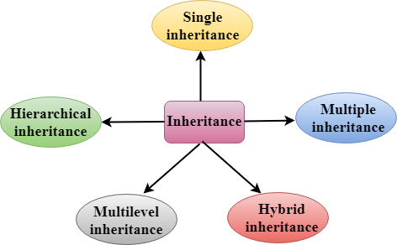

Slide 111
Derived Classes - A Derived class is defined as the class derived from the base class.
Syntax - class derived_class_name :: visibility-mode base_class_name
{
// body of the derived class.
}
where -
derived_class_name - It is the name of the derived class.
visibility mode - The visibility mode specifies whether the features of the base class are publicly inherited or privately inherited. It can be public or private.
base_class_name - It is the name of the base class.
When the base class is privately inherited by the derived class, public members of the base class becomes the private members of the derived class. Therefore, the public members of the base class are not accessible by the objects of the derived class only by the member functions of the derived class.
When the base class is publicly inherited by the derived class, public members of the base class also become the public members of the derived class. Therefore, the public members of the base class are accessible by the objects of the derived class as well as by the member functions of the base class.

Slide 112

Note -
In C++, the default mode of visibility is private.
The private members of the base class are never inherited.
Single Inheritance -
Single inheritance is defined as the inheritance in which a derived class is inherited from the only one base class.

Slide 113
Single Level Inheritance Example: Inheriting Fields -
#include<iostream.h>
#include<conio.h>
class Account
{
public:
float salary = 60000;
};
class Programmer: public Account
{
public:
float bonus = 5000;
};
void main()
{
Programmer p1;
cout<<"Salary: "<<p1.salary<<endl;
cout<<"Bonus: "<<p1.bonus<<endl;
}

Slide 114
Single Level Inheritance Example: Inheriting Methods -
#include<iostream.h>
#include<conio.h>
class Animal
{
public:
void eat()
{
cout<<"Eating..."<<endl;
}
};
class Dog: public Animal
{
public:
void bark()
{
cout<<"Barking...";
}
};
void main()
{
Dog d1;
d1.eat();
d1.bark();
}

Slide 115
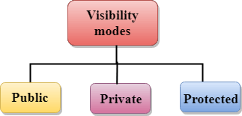
How to make a Private Member Inheritable –
The private member is not inheritable. If we modify the visibility mode by making it public, but this takes away the advantage of data hiding.
C++ introduces a third visibility modifier, i.e., protected. The member which is declared as protected will be accessible to all the member functions within the class as well as the class immediately derived from it.
Visibility modes can be classified into three categories -
Public - When the member is declared as public, it is accessible to all the functions of the program.
Private - When the member is declared as private, it is accessible within the class only.
Protected - When the member is declared as protected, it is accessible within its own class as well as the class immediately derived from it.

Slide 116
Visibility of Inherited Members -
Base class visibility | Derived class visibility
 | Public | Private | Protected
Private | Not Inherited | Not Inherited | Not Inherited
Protected | Protected | Private | Protected
Public | Public | Private | Protected

Slide 117

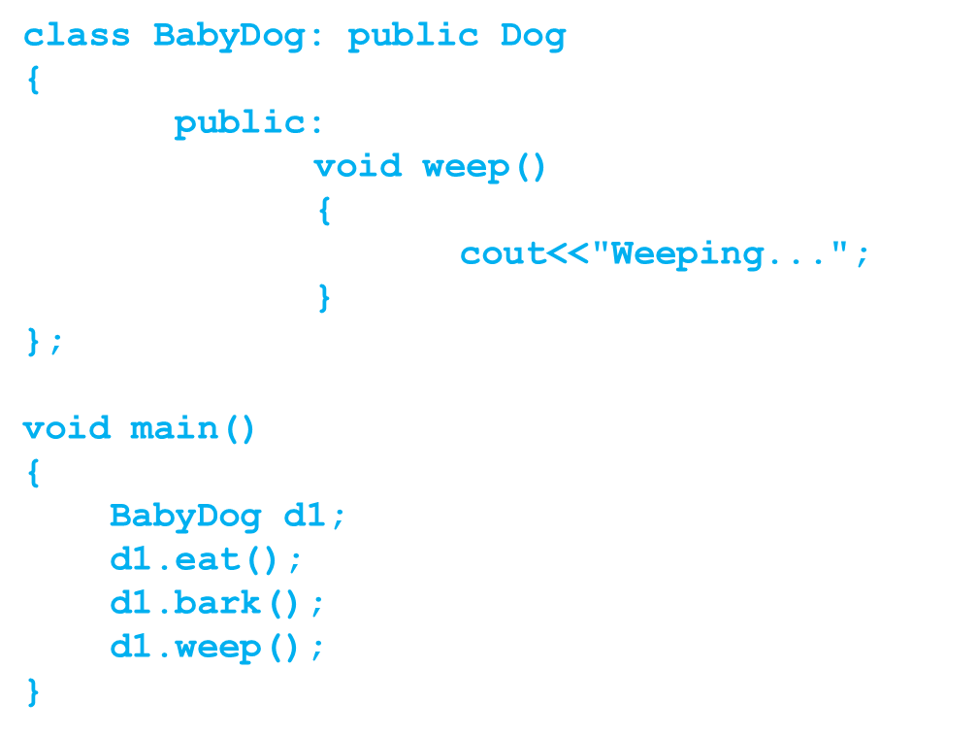
Multilevel Inheritance - Multilevel inheritance is a process of deriving a class from another derived class.
#include<iostream.h>
#include<conio.h>
class Animal
{
public:
void eat()
{
cout<<"Eating..."<<endl;
}
};
class Dog: public Animal
{
public:
void bark()
{
cout<<"Barking..."<<endl;
}
};

Slide 118
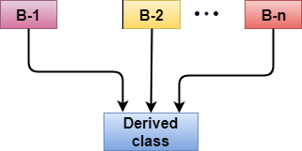
Multiple Inheritance -
Multiple inheritance is the process of deriving a new class that inherits the attributes from two or more classes.
Ambiguity Resolution in Inheritance –
Ambiguity can be occurred in using the multiple inheritance when a function with the same name occurs in more than one base class.
Note: Example of Multiple Inheritance and Ambiguity Resolution discussed later.

Slide 119
#include<iostream.h>
#include<conio.h>
class A
{
protected:
int a;
public:
void get_a(int n)
{
a = n;
}
};
class B
{
protected:
int b;
public:
void get_b(int n)
{
b = n;
}
};
class C : public A, public B
{
public:
void display()
{
cout << "The value of a is : " << a;
cout << "The value of b is : " << b;
cout << "Addition of a and b is : “ << (a+b);
}
};
void main()
{
C c;
c.get_a(10);
c.get_b(20);
c.display();
}
Example of Multiple Inheritance

Slide 120
#include<iostream.h>
#include<conio.h>
class A
{
public:
void display()
{
cout << "Class A" << endl;
}
};
class B
{
public:
void display()
{
cout << "Class B" << endl;
}
};
class C : public A, public B
{
void view()
{
A :: display();
B :: display();
}
};
void main()
{
C c;
c.display();
}
Example of Ambiguity Resolution

Slide 121
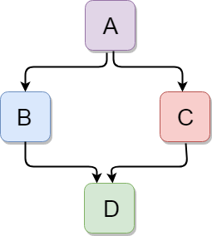
Hybrid Inheritance -
Hybrid inheritance is a combination of more than one type of inheritance.
#include<iostream.h>
#include<conio.h>
class A
{
protected:
int a;
public:
void get_a()
{
cout << "Enter the value of 'a' : " << endl;
cin>>a;
}
};

Slide 122
class B : public A
{
protected:
int b;
public:
void get_b()
{
cout << "Enter the value of 'b' : " << endl;
cin>>b;
}
};
class C
{
protected:
int c;
public:
void get_c()
{
cout << "Enter the value of c is : " << endl;
cin>>c;
}
};

Slide 123
class D : public B, public C
{
protected:
int d;
public:
void mul()
{
get_a();
get_b();
get_c();
cout << "Multiplication of a,b,c is : " <<a*b*c<< endl;
}
};
void main()
{
D d;
d.mul();
}

Slide 124
C++ Storage Class –
Storage class is used to define the lifetime and visibility of a variable and/or function within a C++ program.
Lifetime refers to the period during which the variable remains active and visibility refers to the module of a program in which the variable is accessible.
Storage Classes are used to describe the features of a variable/function. These features basically include the scope, visibility and life-time which help us to trace the existence of a particular variable during the runtime of a program.
There are five types of storage classes, which can be used in a C++ program –
auto | register | extern | static | mutable

Slide 125
Storage Class | Keyword | Lifetime | Visibility | Initial Value
Automatic | auto | Function Block | Local | Garbage
Register | register | Function Block | Local | Garbage
Mutable | mutable | Class | Local | Garbage
External | extern | Whole Program | Global | Zero
Static | static | Whole Program | Local | Zero

Slide 126
Automatic Storage Class –
It is the default storage class for all local variables.
The auto keyword is applied to all local variables automatically.
The auto keyword provides type inference capabilities, using which automatic deduction of the data type of an expression in a programming language can be done.
This consumes less time having to write out things the compiler already knows.
This feature also extends to functions and non-type template parameters.
{
auto int y;
float y = 3.45;
}

Slide 127
#include<iostream.h>
void autoStorageClass()
{
// Declaring an auto variable
// No data-type declaration needed
auto a = 32;
auto b = 3.2;
auto c = “hello world";
auto d = 'G';
// printing the auto variables
cout << a << " \n";
cout << b << " \n";
cout << c << " \n";
cout << d << " \n";
}
void main()
{
// To demonstrate auto Storage Class
autoStorageClass();
}

Slide 128
Register Storage Class –
The register variable allocates memory in register than RAM.
Its size is same of register size. It has a faster access than other variables.
It is recommended to use register variable only for quick access such as in counter.
Note: We can't get the address of register variable.
This storage class declares register variables which have the same functionality as that of the auto variables.
The only difference is that the compiler tries to store these variables in the register of the microprocessor if a free register is available. This makes the use of register variables to be much faster than that of the variables stored in the memory during the runtime of the program.
If a free register is not available, these are then stored in the memory only.
register int counter=0;

Slide 129
#include<iostream.h>
void registerStorageClass()
{
// declaring a register variable
register char b = 'G';
// printing the register variable 'b'
cout << "Value of the variable b"<< b;
}
void main()
{
// To demonstrate register Storage Class
registerStorageClass();
}

Slide 130
Extern Storage Class –
The extern variable is visible to all the programs.
It is used if two or more files are sharing same variable or function.
Extern storage class simply tells us that the variable is defined elsewhere and not within the same block where it is used.
Also, a normal global variable can be made extern as well by placing the ‘extern’ keyword before its declaration/definition in any function/block.
extern int counter=0;

Slide 131
#include <iostream>
int x;
void externStorageClass()
{
extern int x;
cout << “Value is: “<< x << "\n";
x = 2;
cout << “Modified value is: “<< x;
}
void main()
{
externStorageClass();
}

Slide 132
Static Storage Class –
The static variable is initialized only once and exists till the end of a program.
It retains its value between multiple functions call.
The static variable has the default value 0 which is provided by compiler.
Thus, no new memory is allocated because they are not re-declared.
Their scope is local to the function to which they were defined.
Global static variables can be accessed anywhere in the program.
static int counter=0;

Slide 133
#include<iostream.h>
#include<conio.h>
void func()
{
static int i=0; //static variable
int j=0; //local variable
i++;
j++;
cout<<"i=" << i<<" and j=" <<j<<endl;
}
void main()
{
func();
}

Slide 134
Mutable Storage Class –
Sometimes there is a requirement to modify one or more data members of class/struct through const function even though you don’t want the function to update other members of class/struct.
This task can be easily performed by using the mutable keyword.
The keyword mutable is mainly used to allow a particular data member of const object to be modified.
When we declare a function as const, this pointer passed to function becomes const.
Adding mutable to a variable allows a const pointer to change members.
mutable int counter=0;

Slide 135
#include<iostream.h>
#include<conio.h>
class Test
{
public:
int x;
mutable int y;
Test()
{
x = 4;
y = 10;
}
};
void main()
{
// t1 is set to constant
const Test t1;
// trying to change the value
t1.y = 20;
cout << t1.y;
}

Slide 136
Static Keyword –
What is static keyword?
Static is a keyword in C++ used to give special characteristics to an element.
Static elements are allocated storage only once in a program lifetime in static storage area.
They have a scope till the program lifetime.
In C++, static can be –
Static Variables
Static Methods
Static Variable in Functions
Static Class Objects
Static Member Variable in Class
Static Methods in Class
Advantages of Static Keyword -
Memory efficient: Now we don't need to create instance for accessing the static members, so it saves memory. Moreover, it belongs to the type, so it will not get memory each time when instance is created.

Slide 137
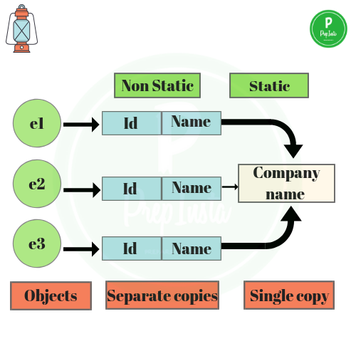

Slide 138
Static Keyword –
Static Field –
A field which is declared as static is called static field.
Unlike instance field which gets memory each time whenever we create object, there is only one copy of static field created in the memory. It is shared to all the objects.
e.g.,
#include<iostream.h>
#include<conio.h>
void main()
{
static int a;
}

Slide 139
Static Keyword –
What are the difference between Field and Variable?
Not all variables are fields.
Local variables of a method are variables, but not fields.
Parameters to a method, property, constructor, or anonymous method are variables, but are not fields.
Not all fields are variables.
e.g., A const member is technically a field, but it is not a variable.

Slide 140
Static Keyword –
Static Method –
A field which is declared as static is called static field.
Unlike instance field which gets memory each time whenever we create object, there is only one copy of static field created in the memory. It is shared to all the objects.
e.g.,
#include<iostream.h>
#include<conio.h>
static void display()
{
cout<<"hello world...!";
}
void main()
{
display();
}

Slide 141
Static Keyword –
Static Variables in Functions –
Static variables when used inside function are initialized only once, and then they hold there value even through function calls.
These static variables are stored on static storage area , not in stack.
e.g.,
#include<iostream.h>
#include<conio.h>
void display()
{
static int p = 99;
cout<<“Value is: ”<<p;
}
void main()
{
display();
}

Slide 142
Static Keyword –
Static Member Variable in Class –
Static data members of class are those members which are shared by all the objects.
Static data member has a single piece of storage, and is not available as separate copy with each object, like other non-static data members.
Static member variables (data members) are not initialized using constructor, because these are not dependent on object initialization.
It must be initialized explicitly, always outside the class. If not initialized, Linker will give error.

Slide 143
#include<iostream.h>
#include<conio.h>
class X
{
public:
static int i;
X()
{
}
};
int X :: i=1;
void main()
{
X obj;
cout << obj.i;
}

Slide 144
Static Keyword –
Static Methods in Class –
Just like the static data members or static variables inside the class, static member functions also does not depend on object of class.
We are allowed to invoke a static member function using the object and the ‘.’ operator but it is recommended to invoke the static members using the class name and the scope resolution operator.
Static member functions are allowed to access only the static data members or other static member functions, they can not access the non-static data members or member functions of the class.

Slide 145
#include<iostream.h>
#include<conio.h>
class Sample
{
public:
static void printMsg()
{
cout<<"Welcome to GGI";
}
};
void main()
{
Sample :: printMsg();
}

Slide 146
Static Keyword –
Static Class Objects –
Static keyword works in the same way for class objects too.
Objects declared static are allocated storage in static storage area, and have scope till the end of program.
Static objects are also initialized using constructors like other normal objects. Assignment to zero, on using static keyword is only for primitive data types, not for user defined data type.

Slide 147
class Abc
{
int i;
public:
Abc()
{
i=0;
cout << "constructor";
}
~Abc()
{
cout << "destructor";
}
};
void f()
{
static Abc obj;
}
void main()
{
int x=0;
if(x==0)
{
f();
}
}

Slide 148
Arrays –
Definition – An array is a collection of similar items stored in contiguous memory locations. In programming, sometimes a simple variable is not enough to hold all the data.
Note - A C++ array has a fixed-size.
Why do we need arrays?
Arrays are very important in any programming language. They provide a more convenient way of storing variables or a collection of data of a similar data type together instead of storing them separately. Each value of the array will be accessed separately.

Slide 149
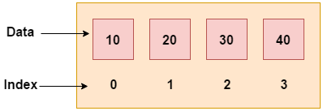
Advantages of Array –
Array elements can be traversed easily.
Easy to manipulate array data.
Array elements can be accessed randomly.
Arrays facilitate code optimization.
Easy to sort array data.
Disadvantages of Array –
An array has a fixed size.
Allocating more memory than the requirement leads to wastage memory space, and less allocation of memory can create a problem.
The number of elements to be stored in an array must be known in advance.

Slide 150
Types of Array – There are two types of array, such as –
1-D array (One Dimensional Array)
2-D array (Multi Dimensional Array)
Declare an Array in C++ - type array-Name [ array-Size ];
Array Declaration - int arr[10];
Array Initialization - int age[5] = {19, 18, 21, 20, 17}; both are same
int age[] = {19, 18, 21, 20, 17};
Array Initialization –
arr[0] = 19;
arr[1] = 18;
arr[2] = 21;
etc…

Slide 151
One Dimensional Array –
This is an array in which the data items are arranged linearly in one dimension only. It is commonly called a 1-D array.
Syntax - datatype array-name[size];
#include<iostream.h>
#include<conio.h>
void main()
{
int i, arr[5] = {10,20,30,40,50};
cout<<"\nArray elements are: ";
for(i=0;i<5;i++)
{
cout<<" "<<arr[i];
}
}

Slide 152
User Input from array -
#include<iostream.h>
#include<conio.h>
void main()
{
int i, arr[5];
cout<<"\nEnter Array elements are: ";
for(i=0;i<5;i++)
{
cin>>arr[i];
}
cout<<"\nArray elements are: ";
for(i=0;i<5;i++)
{
cout<<" "<<arr[i];
}
}

Slide 153
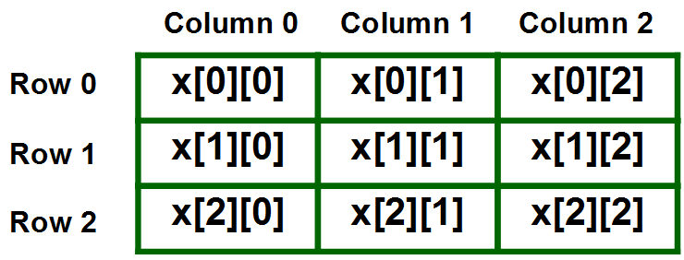
Two (Multi-dimensional) Dimensional Array –
The multidimensional array is also known as rectangular arrays in C++. It can be two dimensional or three dimensional. The data is stored in tabular form (row ∗ column) which is also known as matrix.
Syntax - data type array-name[size][size];
Note:
2D arrays can be defined as an array of arrays.
It can also represent a Matrix.

Slide 154
Initializing a 2D array in C++ -
Type – I
int arr[4][2] = {
{1234, 56},
{1212, 33},
{1434, 80},
{1312, 78}
} ;
Type – II
int arr[4][2] = {1234, 56, 1212, 33, 1434, 80, 1312, 78};

Slide 155
Printing a 2D Array in C++ -
Taking 2D Array Elements As User Input -
#include<iostream.h>
void main( )
{
int arr[4][2] = {
{ 10, 11 },
{ 20, 21 },
{ 30, 31 },
{ 40, 41 }
} ;
int i,j;
cout<<"Printing a 2D Array:\n";
for(i=0;i<4;i++)
{
for(j=0;j<2;j++)
{
cout<<"\t"<<arr[i][j];
}
cout<<endl;
}
}
#include<iostream>
using namespace std;
main( )
{
int s[2][2];
int i, j;
cout<<"\n2D Array Input:\n";
for(i=0;i<2;i++)
{
for(j=0;j<2;j++)
{
cout<<"\ns["<<i<<"]["<<j<<"]= ";
cin>>s[i][j];
}
}
cout<<"\nThe 2-D Array is:\n";
for(i=0;i<2;i++)
{
for(j=0;j<2;j++)
{
cout<<"\t"<<s[i][j];
}
cout<<endl;
}
}

Slide 156
Passing Array to Function - In C++, to reuse the array logic, we can create function. To pass array to function in C++, we need to provide only array name.
Syntax - functionname(arrayname); //passing array to function
Example –
#include<iostream.h>
#include<conio.h>
void printArray(int arr[])
{
cout << "Array elements: "<< endl;
for (int i = 0; i < 5; i++)
{
cout<<arr[i]<<"\n";
}
}
void main()
{
int arr1[5] = { 10, 20, 30, 40, 50 };
//passing array to function
printArray(arr1);
}

Slide 157
Passing Array to Function (Multi Dimensional Array) -
Example –
#include<iostream.h>
#include<conio.h>
void print(int arr[3][3])
{
int i, j;
for (i = 0; i < 3; i++)
{
for (j = 0; j < 3; j++)
{
cout<<" "<<arr[i][j];
}
cout<<"\n";
}
}
void main()
{
int arr[3][3] = {{1, 2, 3}, {4, 5, 6}, {7, 8, 9}};
print(arr);
}

Slide 158
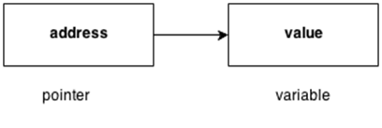
Pointers -
The pointer in C++ language is a variable, it is also known as locator or indicator that points to an address of a value.
Advantage of pointer -
1) Pointer reduces the code and improves the performance, it is used to retrieving strings, trees etc. and used with arrays, structures and functions.
2) We can return multiple values from function using pointer.
3) It makes you able to access any memory location in the computer's memory.

Slide 159
Usage of pointer -
There are many usage of pointers in C++ language.
Dynamic memory allocation - In c language, we can dynamically allocate memory using malloc() and calloc() functions where pointer is used.
2) Arrays, Functions and Structures - Pointers in c language are widely used in arrays, functions and structures. It reduces the code and improves the performance.
Symbols used in pointer -
Symbol | Name | Description
& (ampersand sign) | Address operator | Determine the address of a variable.
∗ (asterisk sign) | Indirection operator | Access the value of an address.

Slide 160
Declaring a Pointer
/* WAP to swap two numbers without using 3rd variable*/
#include<iostream.h>
#include<conio.h>
void main()
{
int a = 20,b = 10;
*p1 = &a;
*p2 = &b;
cout<<“Before swap: *p1= “<<*p1;
cout<<“Before swap: *p2= “<<*p2;
*p1 = *p1 + *p2;
*p2 = *p1 - *p2;
*p1 = *p1 - *p2;
cout<<“After swap: *p1= “<<*p1;
cout<<“After swap: *p2= “<<*p2;
}
Pointer to int – int *a;
Pointer to char – char *c;
#include<iostream.h>
#include<conio.h>
void main()
{
int number = 30;
int ∗p;
p = &number;
cout<<“Value of number: ”<<number;
cout<<“Value of p: ”<<p;
cout<<“Value of *p: ”<<*p;
}

Slide 161
Pointer to Variable -
#include<iostream.h>
#include<conio.h>
void main()
{
int n,*p;
cout<<“Enter the number: ”;
cin>>n;
p = &n;
cout<<“\nValue of n: ”<<n;
cout<<“\nAddress of n: ”<<&n;
cout<<“\nValue of p: ”<<p;
cout<<“\nAddress of p: ”<<&p;
cout<<“\nContent of p: ”<<*p;
}

Slide 162
Pointer to Array -
#include<iostream.h>
#include<conio.h>
void main()
{
int arr[5],i,*p;
cout<<"Enter the array elements: ";
for(i=0;i<5;i++)
{
cin>>arr[i];
}
p=&arr[0];
cout<<"Value is: "<<*p; //it prints the first element of array
}

Slide 163
Traversing an array using Pointer -
#include<iostream.h>
#include<conio.h>
void main()
{
int arr[5],i,*p;
cout<<"Enter the array elements: ";
for(i=0;i<5;i++)
{
cin>>arr[i];
}
p=&arr[0];
cout<<"\nArray Elements are:\n";
for(i=0;i<5;i++)
{
cout<<" "<<*(p+i);
}
}

Slide 164
Pointer to Function – Type - I
#include<iostream.h>
#include<conio.h>
void sum(int x, int y)
{
int c = (x+y);
cout<<"Sum is: "<<c;
}
void main()
{
void (*fp)(int p, int q);
fp = sum;
fp(10,20);
}

Slide 165
Pointer to Function – Type - II
#include<iostream.h>
#include<conio.h>
int sum(int x, int y)
{
int c = (x+y);
return c;
}
void main()
{
int (*fp)(int a, int b);
fp = sum;
int s = fp(10,20);
cout<<"Value of s: "<<s;
}

Slide 166
Pointer to Structure -
#include<iostream.h>
#include<conio.h>
struct student
{
int id;
char name[10];
float perc;
};
void main()
{
struct student record = {1,"GGI",90.5};
struct student *ptr;
ptr = &record;
cout<<"\nRecords of Students\n";
cout<<"Id is: "<<ptr->id;
cout<<"\nName is: "<<ptr->name;
cout<<"\nPercentage is: "<<ptr->perc;
}

Slide 167
Constant Pointer
#include<iostream.h>
#include<conio.h>
void main()
{
int arr[2] = {10,20};
int *const ptr = &arr[0];
cout<<"Value is: "<<*ptr;
}

Slide 168
This Pointer -
In C++ programming, this is a keyword that refers to the current instance of the class.
There can be 3 main usage of this keyword in C++.
It can be used to pass current object as a parameter to another method.
It can be used to refer current class instance variable.
It can be used to declare indexers.
What is indexers in C++?
C++ indexers are usually known as smart arrays. A C++ indexer is a class property that allows you to access a member variable of a class or struct using the features of an array. In C++, indexers are created using this keyword. Indexers in C++ are applicable on both classes and structs.
NOTE: Specially indexers are used in C# (.NET Platforms by using get() & set() method)

Slide 169
#include<iostream.h>
#include<conio.h>
class Employee
{
public:
int id;
char nm;
float sal;
Employee(int id, char nm, float sal)
{
this->id = id;
this->nm = nm;
this->sal = sal;
}
void display()
{
cout<<"\nId is: "<<id;
cout<<"\nName is: "<<nm;
cout<<"\nSalary is: "<<sal;
}
};
void main()
{
//creating an object of Employee
Employee e1(101, 'S', 89.5);
//creating an object of Employee
//Employee e2 = Employee(102, 'N', 59000);
e2.display();
}

Slide 170
Memory Management in C++ -
What is Memory Management?
Memory management is a process of managing computer memory, assigning the memory space to the programs to improve the overall system performance.
Why is Memory Management required?
Arrays store the homogeneous data, so most of the time, memory is allocated to the array at the declaration time. Sometimes the situation arises when the exact memory is not determined until runtime. To avoid the wastage of memory, we can use the new operator to allocate the memory dynamically at the run time.
Memory Management Operators -
In C Language, we are using malloc(), calloc() and realloc() functions to allocate the memory dynamically at run time along with free() function is used to deallocate the allocated memory. C++ supports all these but along with there are two unary operators such as new and delete to perform the same tasks respectively.
New Operator -
A new operator is used to create the object while a delete operator is used to delete the object. When the object is created by using the new operator, then the object will exist until we explicitly use the delete operator to delete the object.

Slide 171
Syntax - pointer_variable = new data-type
Example –
int *p = new int;
float *q = new float;
Assigning a value to the newly created object –
Syntax - pointer_variable = new data-type(value);
Example -
int *p = new int(45);
float *p = new float(9.8);
How to create a single dimensional array -
Syntax - pointer-variable = new data-type[size];
Example –
int *a1 = new int[8];
float *a2 = new float[5];

Slide 172
Memory Management in C++ -
Delete Operator -
When memory is no longer required, then it needs to be deallocated so that the memory can be used for another purpose.
Syntax - delete pointer_variable;
Example –
delete p;
delete q;
Delete memory space from array -
Syntax - delete [size] pointer_variable;
Example –
delete [ ] pointer_variable;

Slide 173
Example on Integer variable -
#include<iostream.h>
#include<conio.h>
void main()
{
int *ptr;
ptr = new int;
cout<<"Enter the number: ";
cin>>*ptr;
cout<<"\nRequired number is: "<<*ptr;
}

Slide 174
Example on Array -
#include<iostream.h>
#include<conio.h>
void main()
{
int i,size;
cout<<"Enter the size of the array : ";
cin >> size;
int *arr = new int[size];
cout<<"\nEnter the element : ";
for(i=0;i<size;i++)
{
cin>>arr[i];
}
cout<<"\nThe elements that you have entered are :";
for(i=0;i<size;i++)
{
cout<<arr[i]<<" ";
}
delete arr;
}

Slide 175
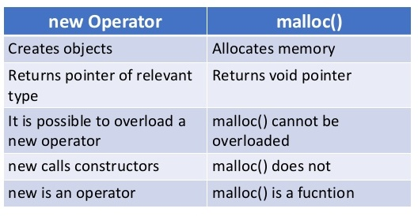
Advantages of the new operator -
The following are the advantages of the new operator -
It does not use the sizeof() operator as it automatically computes the size of the data object.
It automatically returns the correct data type pointer, so it does not need to use the typecasting.
Like other operators, the new and delete operator can also be overloaded.
It also allows you to initialize the data object while creating the memory space for the object.
Difference between new and malloc() operator -

Slide 176
Difference between delete and free() operator -
The following are the differences between delete and free() in C++ are:
The delete is an operator that de-allocates the memory dynamically while the free() is a function that destroys the memory at the runtime.
The delete operator is used to delete the pointer, which is either allocated using new operator or a NULL pointer, whereas the free() function is used to delete the pointer that is either allocated using malloc(), calloc() or realloc() function or NULL pointer.
When the delete operator destroys the allocated memory, then it calls the destructor of the class in C++, whereas the free() function does not call the destructor; it only frees the memory from the heap.
The delete() operator is faster than the free() function.

